Slide 1
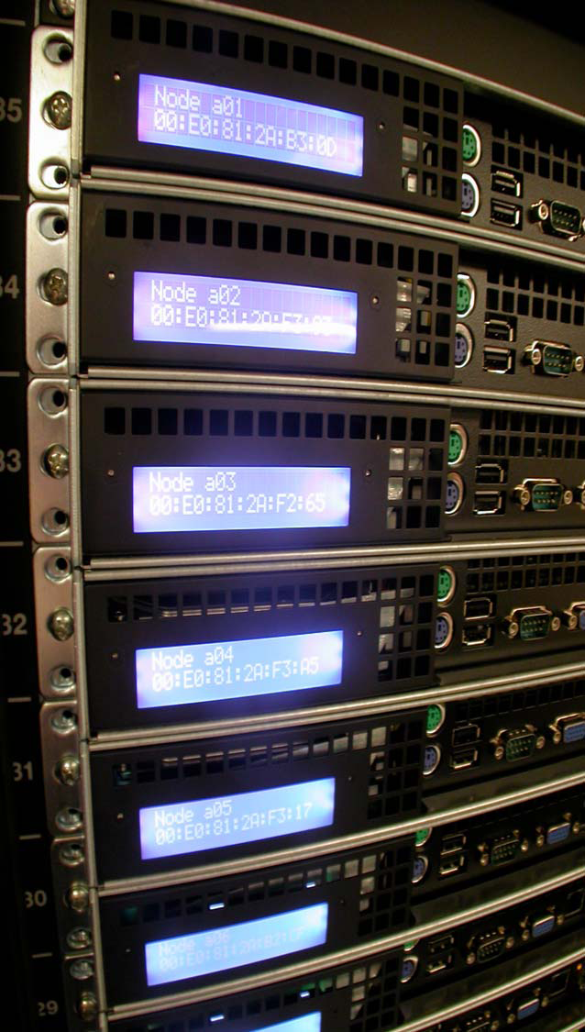
SGE Grid Computing
Introduction
pbuenrostro@stec-inc.com

Slide 2
What is SGE Grid?
SGE is a compute farm responsible for accepting, scheduling, dispatching and managing the remote and distributed execution of standalone, parallel or interactive user jobs

Slide 3
TW SGE Compute Farm Details
SGE is running on twmatrix01-twmatrix15(twmatrix13 currently offline)
Multi-processor and multi-core hosts, 168 total processor cores approx.
From 32GB to 256GB of memory depending on the host
1 GB/s Ethernet network connection
SGE is configured to allow 8 batch jobs per host and 2 Interactive
No job limit per user(can be implemented)
User fair share is enabled
All users have the same priority
Specific hardware resource requests can be made when submitting
Currently we have more processor cores than EDA licenses
Soon will have login hosts to be used exclusively for submitting jobs to SGE

Slide 4
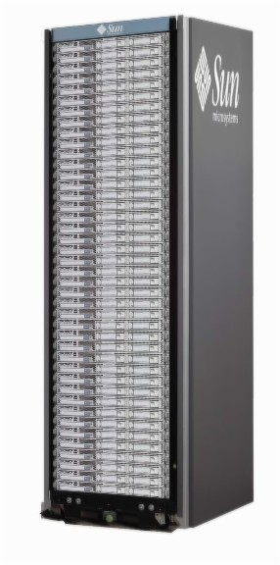

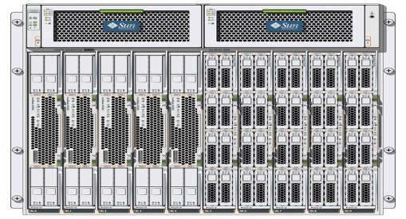
How does SGE work?
Distributed
Resource
Manager
User submits the job
SGE dispatches the job to the next available execution grid host
Grid host executes

Slide 5
What type of jobs can I submit?
Batch Like a shell script
Interactive Requires user interaction
Parallel Single job on many nodes

Slide 6
How do I submit a Batch job?
Login to a matrix host**
Source the sge environment variables*
Submit the batch job with qsub command
Check the job status with qstat –u username
*source /stec/apps/sge/sge6_2u5/grid_setup.csh for C-SHELL
source /stec/apps/sge/sge6_2u5/grid_setup.sh for BASH SHELL
** This will soon change, will have login hosts where you can create VNC, NX or direct login sessions

Slide 7
What are some of the basic qsub options?
-V to export all environment variables
-cwd to run the job from the current working directory
-o to send standard output to a different file
-e to send standard error to a different file
-j y to merge standard error stream with output
-m e to email you at the end of a job
-M username@stec-inc.com Email address to send
Example: qsub –V –cwd -m e –M amellan@stec-inc.com sleep.sh

Slide 8
How do I submit an Interactive job?
Source the sge environment variables*
Submit the job with qrsh command
Check the job status with qstat –u username
*No need to source environment variables for every job

Slide 9
What are some of the basic qrsh options?
-V to export all environment variables
-cwd to run the job from the current working directory
-now y to start job immediately
Example: qrsh –V –cwd –now y dc_shell

Slide 10
How do I delete my job(s)?
qdel PID To delete a specific Job
qdel –u username To delete all my jobs
Example: qdel 123, qdel –u iron

Slide 11
Some other useful commands
qstat –f displays cluster names and usage
qhost resources load and usage(cpu,mem,swap)
qhold hold back a pending submitted job from execution
qrls release held job from execution
qalter modify pending batch job
You can type any command with “–help” for all options

Slide 12
Questions?

